Slide 1


RA vs RCP
Overview
8. January 2026
Tobias Belitz
HCTD/HCTS/HCTSN
Renesas Electronics Corporation
© 2026 Renesas Electronics Corporation. All rights reserved.
RENESAS CONFIDENTIAL

Slide 2
Architecture Trend
OR
Domain
Hybrid (Domain + Zone)
Zone
VC integrated type
VC centralized type
ADC
Central ECU
ADC
OR
Central compute
Central compute
Central compute
Central GW
CDC
ADC
CDC
ADC
CDC
ADC
CDC
PT
CS
BD
CDC
PT
CS
BD
PT
CS
Zone ECU
VCU
Zone ECU
Zone
Zone
Zone
Zone
BD
PT
CS
BD
PT
CS
BD
Dev cost minimization
System BOM cost minimization
The industry is experiencing significant transformation. Along with this, the E/E architecture will also change substantially. However, at this stage, we will focus only on two key changes related to data communication rather than covering all the modifications

Slide 3

Architecture type – tendency
Service
application
RT control
function
I/O control
function
Sensor(s)
GbE
100MbE
Actuator(s)
CAN/LIN
Function centralization makes either zonal ECU to simplify or central compute to require higher performance
Hybrid (Domain + Zone)
Zone
*) In case of FOTA introduced
VC integrated type
VC centralized type
Central ECU*
ADC
CDC
Central compute
Central compute
Central compute
OR
B: IO Control
A: Increase of data routing
PT
CS
Zone
Zone
VCU
Zone
Zone
Zone+PT
Zone+CS
Zone
Zone
I/O
I/O
I/O
I/O
performance
B: IO Server
Routing Accelerator
PT/CS is reused from legacy so that required performance is not changed
Zone requires performance depends on actuator(s) connected to Zone
VCU merged several vehicle control functions requires higher performance than legacy
Zone requires performance depends on actuator(s) connected to Zone
Zone requires performance depends on vehicle function(s) or actuator(s) connected to Zone
All VC functions are integrated into central so that a powerful RT performance is required
I/O hub has only signal routing function and requires minimum performance
Remote Control Protocol
VCU: Vehicle Control Unit (incl. DCU), PT: Powertrain (xEV), CS: Chassis and Safety, BD: Body (BCM), ADC: ADAS Domain Controller, CDC: Cockpit Domain Controller, HPC: High Performance Compute

Slide 4
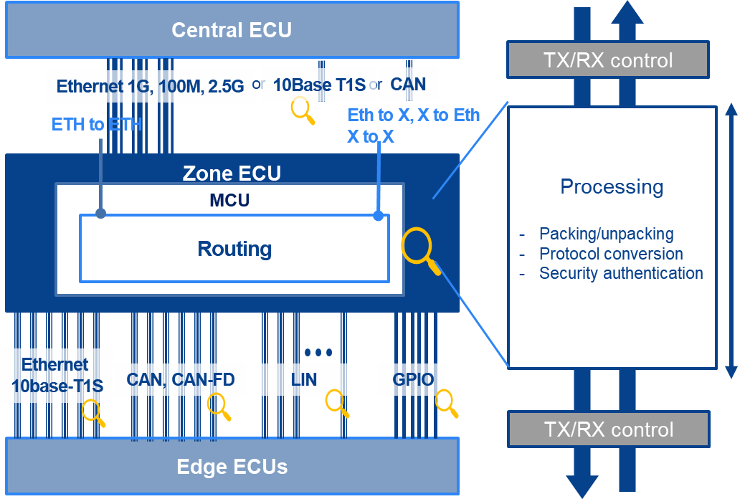
Routing vs Remote
MCU
Edge Device
Application
RCP Server
RCP Client
RCP Core
Sensor HAL (API)
Eth Interface
SPI
I2C
Eth Interface
External Entities
The routing acceleration covers product’s network interfaces and accelerate communication between them. It provides forwarding and protocol conversions processing.
RCP Clients communicate with Endpoints through RCP Servers using the Remote Control Protocol and also interact with external Entities connected to the Endpoints.

Slide 5
Routing Accelerator vs RCP device
 | Routing Accelerator | Remote Control Protocol
Standard function | No; proprietary | Yes; OPEN Alliance
Function | Automated packaging (Un-) of data between CAN and Ethernet | Clint Server communication protocol, basically to control edge devices from the central compute unit
Packaging | IP (Soft macro) | Product (e.g MCU)
Data | Ethernet and CAN | Control of I2C, SPI, ADC, PWM etc. via Eth. frames
Location | Zone Controller | RC Clint → HPC RC Server→ Edge
Safety | Not covered; E2E protection if needed is not terminated by the RA, it is transparent routed | Covered; Edge node can add E2E protection to the Data
Security | MACsec, SecOC (TBD) | MACsec can be addon to the Ethernet communication

Slide 6
Renesas.com
© 2025 Renesas Electronics Corporation. All rights reserved.
RENESAS CONFIDENTIAL

